Slide 1


Portfolio project presentation
Richard Klein
MIS581 – Capstone – Business Intelligence & Data Analytics
Colorado State University – Global Campus
Dr. Justin Bateh
April 9, 2022
Notes:
Hello, my name is Richard Klein, and welcome to the Portfolio Project Presentation where we will review the use of data analytics and data visualization to help Feeding America better allocate its financial and non-financial resources in order to help Feeding America meet its mission of eradicating hunger in the United States. Today we see the results of using SAS and Tableau for data analysis and data visualization on the U.S. Census Bureau population survey - the 2021 Annual Social and Economic Supplement (ASEC). We will have an overview of Feeding America and its mission, we will review the objectives of the study, why we undertook the study, ethical, privacy and security concerns regarding the data, the studies design, the hypothesis used, the findings, and finally we will discuss conclusion and next steps.

Slide 2
Data Analytics and Visualization for Feeding America Resource Allocation
Feeding America – Founded in 1979 by John Van Hengal (Feeding America, 2020)
Network of 200 Food Banks and 60,000 Food Pantries (Feeding America, 2020)
Mission – Eradicate hunger
Notes:
To begin, just a little background on Feeding America that most of you on the executive committee are probably pretty well-aware of. John Van Hengal our esteemed founder found himself volunteering at a food bank back in the 1970’s (Feeding America, 2020). While volunteering one day he spoke to a young mother, who was food insecure, that talked about searching behind grocery stores for discarded food, and she wondered why food was not stored in one location so those in need could pick it up (Feeding America, 2020). . John was obviously listening, his first food bank called St. Mary’s Food Bank distributed over 300,000 lbs of food in its first year (Feeding America, 2020). . This was the beginning of what was known as Second Harvest, now Feeding America where in the last year we have distributed 6.6 billion meals from 200 food banks and 60,000 food pantries (Feeding America, 2020). . Serving 1 in 7 Americans (Feeding America, 2020). . John would be very proud if he were here today.

Slide 3

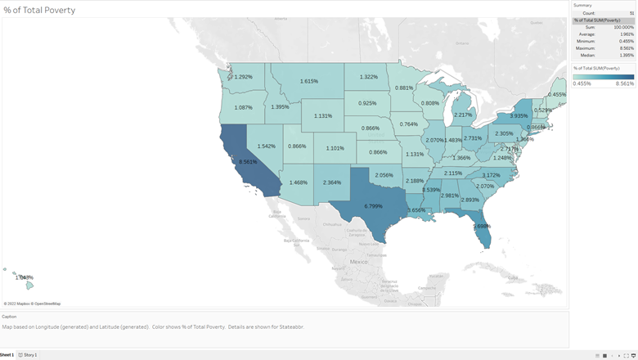
Objectives Figure 1 Percentage of Total Poverty by State Use publicly available data such as the 2021 Annual Social and Economic Supplement Use Publicly available tools such as SAS and Tableau for analysis and visualization of the data Use the data and visualization for Feeding America’s resource allocation Note: Image % of Total Poverty, by R.Klein, 2022. Non-profit organizational success is measured by resources taken in, what resources are output, the efficiency of redirecting those resources, and stakeholder satisfaction (Sarikaya & Buhl, 2021).
Notes:
So, John would be proud. Why change anything? Because we have the ability? No, because we have the obligation to be better. With over 38 million people, including 12 million children living with food insecurity, the more impactful we can be per week, per month, per year, the better we can accomplish our mission (Feeding America, 2022). Our objectives for this study are to use publicly available data such as the U.S. Census Bureau 2021 Annual Social and Economic Supplement (ASEC), use publicly available tools such as SAS and Tableau for analytics and visualization and use the data analytics and data visualization to help Feeding America allocate their resources more efficiently to those in need. After all we are measured by what we take in, what we give out, how good we are at that process, and of course how satisfied those that we answer to are (Sarikaya & Buhl, 2021).

Slide 4
Why Now?
38 million Food Insecure
How we are Measured
Input, Output, Efficiency, satisfaction
Cut Expenses
Reliance on Field Experts is labor and cost intensive (Erete et al., 2016).
Less Expensive
Technology less expensive , storage costs lowered, processing power increased so that large investment not necessary (West, 2019).
Notes:
So why now? I have already mentioned 38 Million people are food insecure, and that we are measured on what we bring in, send out, how effective we are at that, and how happy people are with us. But what else? In order to take in more resources for people and in return send out more resources, we have to be more cost effective, that means that in todays age of freely available high quality government data, and inexpensive analytics tools, that we need to reimagine how we do, what we do. First, the reliance on expensive field experts for our data may be a luxury we can no longer afford (Erete et al., 2016). Perhaps some of them can be repurposed internally for data analytics work. Secondly, the technology to produce our own low-cost data analysis was previously cost prohibitive due to the price of technology, processing, and storage (West, 2019). Today those expenses have been lowered significantly and are no longer an obstacle to our organization.

Slide 5
Ethics Privacy Security
“Data analytics is a broad term that covers data governance, data science, data visualization, AI, and more (El-Wakeel, 2021).”
Ethics as it relates to data analytics has to do with the moral obligations in collection, storage, and use of sensitive information and what impacts this has on individuals and organizations (Cole, 2021).
Notes:
Before we get any further in the study let us have a quick discussion about ethical, privacy, and security considerations. What do these mean to us? Why should this be addresses? Let me answer the second question first. Data is an economic asset to both individuals and organizations (Davis & Patterson, 2012). It’s powerful, and as such should be treated with respect. There are five principles of data ethics: ownership, transparency, privacy, intention and outcomes (Cole, 2021. Ownership dictates that individuals have ownership over their information (Cole, 2021). Transparency means that individuals have a right to know why data is collected, and how it will be used (Cole, 2021). Privacy means keeping personally identifiable information confidential and secure (Cole, 2021). Intent deals with ethical collection, storage and use of data (Cole, 2021). Outcomes relates to not causing harm with dissemination of analysis (Cole, 2021). For Feeding America ethical considerations throughout the process of collection, storage, and use of data is key. We are collecting U.S Census Bureau data which is anonymized through Differential Privacy but will make sure to exclude anything deemed a privacy concern (U.S. Census Bureau, 2022). Storage of data will require secure network, applications, and access controls. Ethical use of data will require that we review our data, research, and dissemination of outcomes for any potential bias that may harm others or potentially harm Feeding America’s reputation and mission.

Slide 6
Ethics Privacy Security
Information privacy or access to personally Identifiable information in collection of data, storage, verification, analytics, and Dissemination of findings (Wieringa et al., 2021)
Notes:
Back to Privacy for a moment. This is an important topic. While we understand that data is secured through Differential Privacy protections by the U.S. Census Bureau, we also understand that as computers get more powerful, and data of individuals is circulated more online, combinations of data including our own data analytics, big data, and other data bases could compromise the personal information of individuals and by extension or own mission (U.S. Census Bureau, 2022). Therefore, every measure has been taken to further anonymize household data in this presentation including the removal of any household identifiers provided by U.S. Census Bureau data. These privacy considerations should be taken with any data used by Feeding America in the future.

Slide 7
Ethics Privacy Security
Confidentiality
Integrity
Availability
Notes:
Not that we have collected data, are storing data, and are using data, what sort of security protections do we have in place? We have secure systems in place that will guard the confidentiality, integrity and availability of information. Confidentiality means that we only allow access to those individuals, both internal and external, that should have access to data by ensuring privacy of communications through encryption, securely storing information in our hardened systems, authenticating users using complex password protections, and having proper access controls or rather giving people only the access that they need to do their jobs (Oracle, 2022). Integrity refers to keeping the accuracy, reliability and completeness of data, by securing systems and protecting data from deletion and corruption (Talend, 2022). This also refers to access controls, encryption, and software such as antivirus and malware protection. Finally, availability of data refers to ensuring that people and systems that are authorized to have access to data, have access when and where they need it (Techopedia, 2017). Key aspects of maintaining availability refer to having a combination of tool and technologies that ensure resistance to deliberate attempts to block access to data, scalability or ample resources and system performance so that data analytics can be performed, flexibility to manage users of the data, and ease of use (Oracle, 2022).

Slide 8

Figure 2 Research Design Note: Data Analysis, by USER5738668. (https://uxdesign.cc/how-to-use-quantitative-and -qualitative-research-methods-in-ux-design-5b9606c00a42 /.). In the Public Domain.
Design
Quantitative
Population design
Existing research – U.S. Census Bureau 2021 Annual Social and Economic Supplement (ASEC)
Tools
SAS – Descriptive and Predictive Analytics
PROC MEANS, UNIVARIATE, FREQ, CORR, LOGISTIC
Tableau – Data Visualization
VISUALIZATIONS OF TABLE DATA, GEOGRAPHIC DATA
Notes:
OK, now that we have discussed ethical, privacy, and security considerations, lets get back to the study. This study was designed as a quantitative research approach using population design and existing data from the U.S Census Bureau 2021 Annual Social and Economic Supplement. This data will be extracted, transformed, and loaded with analytics performed using SAS for descriptive and predictive analysis and Tableau for data visualization of tables and mapping. Descriptive analytics included evaluating quantitative data using techniques such as PROC MEANS and PROC UNIVARIATE in SAS. This provided the required distribution and characteristics of the data in order to perform other functions (Elliott & Woodward, 2020). PROC FREQ provided counts for qualitative data, and analysis using tabulation tables (Elliott & Woodward, 2020). Measures of association between variables was conducted using PROC CORR and PROC LOGISTIC (Elliott & Woodward, 20). Data Visualizations in Tableau utilized geographical data such as Metropolitan Statistical Areas (MSA), and States for mapping, and charts for table data.

Slide 9
Hypotheses
Using publicly available income, supplemental income, and geographical data from the 2021 Annual Social and Economic (ASEC) Supplement, and tools such as SAS and Tableau, can Feeding America allocate 100% of their monetary or food-based resources based on greatest need?
Using data from the 2021 Annual Social and Economic (ASEC) Supplement, are there any strong correlations (> .75 Correlation Coefficient) between variables in the dataset, which can help Feeding America in predicting where future resource allocations will need to be made?
Notes:
What business questions were we looking to answer with data analytics and data visualizations. First whether using publicly available U.S. Census Bureau data, and public tools such as SAS and Tableau, can provide Feeding America with the analytics necessary to allocate 100% of their resources based on need? Second, whether there exists strong enough correlation between variables in the data that Feeding America could use the data as predictive tools for resource allocation?

Slide 10
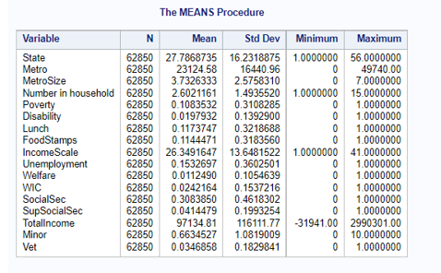
Findings -SAS Figure 3 Descriptive Statistics PROC MEANS 62,850 households Number in Household – Range of 1-15 individuals in household average of 2.6 individuals per household Minors – Range of 0 – 10 in each household Average of .66 minors er household PROC UNIVARIATE showed distribution of data 15,000 possible Rural participants Note: PROC MEANS output, by R.Klein, 2022).
Notes:
OK, now to the fun part. Prior to analysis of data some transformation of data was needed. Destructive, constructive, aesthetic, and structural transformation techniques were employed (Stitch, 2022). The data initially consisted of 130+ variables and 90,000+ rows of information. 26,313 non-respondents were removed from the dataset leaving 62,850 households of data, variables including identification codes were reviewed and removed until only 16 variables were retained. An additional binary qualitative variable was added to the dataset by combining the original dataset, and poverty threshold data from the U.S. Census Bureau and performing a calculation based on total income. Finally, variables were renamed for ease of use. Once transformation was complete analysis began in SAS. PROC MEAN as shown on the slide is typically done for quantitative data such as mean for Total Income which shows $97,134 dollars with a range of -$31,941 to $2,990,301 dollars and Number in household ranging from 1 to 15 individuals with a mean or average of 2.6 individuals per household, but the information was still valuable for qualitative data as close relationships based on a variables total percentage of column are seen in the mean figures for Poverty 10.8%, Lunch (which whether someone received free/reduced priced lunches) 11.7%, whether someone received Food Stamps 11.4%, and whether someone received unemployment 15%. Proc Univariate showed that each individual household could be represented by a state, but each household was not represented by a Metropolitan Statistical Area (MSA) which means that potentially 15,000 households are rural or did not designate the accurate metropolitan area.

Slide 11
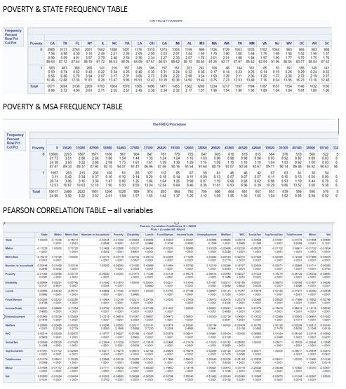
Findings – SAS CONT’d Figure 4 PROC FREQ and PROC CORR output PROC FREQ Poverty and state – CA 8.56% of national total Percentages could be used for resource allocation by state or by MSA and RURAL PROC CORR negative relationships between total income and poverty, foodstamps and lunch variables PROC LOGISTIC Larger households may mean greater odds of Poverty NOTE: FREQUENCY and Correlations, by R.Klein, 2022.
Notes:
Using PROC FREQ provided counts and tabulation tables for analysis. Tabulation of total poverty across states and Metropolitan areas provided statistics regarding total poverty nationally and percentage per state and MSA. These figures could be used in allocation of resources, where for instance California shows 8.56% of poverty total of us, that corresponding amount in resources could be allocated by Feeding America. This can also be broken down between metropolitan areas and rural areas of each state to further pinpoint allocation of resources. PROC CORR was used to find relationships between variables. Negative correlative relationships were found using Pearson Correlation Coefficients between Total income, and poverty, foodstamps and lunch. Meaning that the more income you have the less likely to have a positive answer for these variables. There were also surprisingly weak relationships seen between unemployment and food stamps at .064, supplemental social security and food stamps at .265, and lunch and food stamps at .237. Finally, PROC LOGISTIC was run for regression analysis on qualitative data such as Poverty, and what factors influence a household going into poverty. Factors such as number of individuals in the household showed to be significant in terms of poverty as a 1 unit change in number in household meant a log-odds of poverty increased by nearly 17%, a 1-unit movement in the number of minors in household meant the log-odds of poverty increased by only 1.68%. These findings suggest that mixed or multi-generational households with more individuals may be more at risk of poverty.

Slide 12
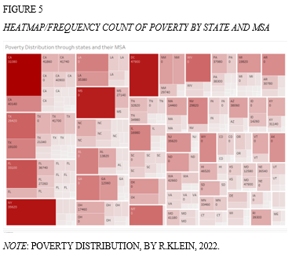
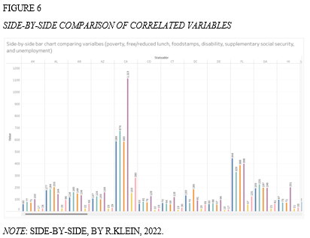
FINDINGS – Tableau Household Poverty data by state, msa, and rural Variables POVERTY, LUNCH, FOODSTAMPS, UNEMPLOYMENT ca – 8.56% MSA – 3.157% Rural CA. - .411% show closely compatible numbers.
Notes:
Let’s transition over to the Tableau data visualization portion of our study. Visualizations of frequency count information previously provided by SAS shows a state-by-state breakdown of poverty figures within MSA’s and in rural areas. What is immediately noticeable is that southern states such as Louisiana, Mississippi, Arkansas, Alabama and western states such as New Mexico, Montana, Idaho and Wyoming all show the 0 MSA or rural area as the predominant location with poverty within the states. To the right you have a side-by-side bar chart with Poverty, free/reduced lunch, disability, supplemental social security and unemployment listed. This side-by-side comparison shows a close correlation between poverty, free/reduced lunch, foodstamps and unemployment figures for each state. One outlier for unemployment in CA shows the number almost double to poverty figure, which may mean that those receiving unemployment are not yet at an income level that indicates poverty.

Slide 13
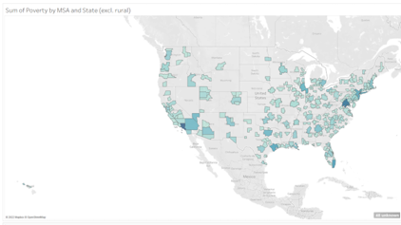
FINDINGS – tableau cont’d Poverty by Msa within state shows 260 selected core-based statistical areas Darker shaded areas denote higher poverty Possible delivery or funding of new food pantries for rural residents depending on previous allocations.
Figure 7
Sum of poverty by msa within state (excluding Rural)
Note: Mapping of Poverty by MSA, BY R.Klein, 2022.
Notes:
One of the main focuses of our data visualization within Tableau is the use of geographic mapping of variables. While the attached map shows poverty by state and MSA, all variables were mapped. Once again variables such as foodstamps, free/reduced hot lunch, and unemployment only showed slight variation in the shading of each MSA. This information gives a visual review of what area have the most substantial issues with poverty and by extension food insecurity within each state based on the U.S. Census Bureau data.

Slide 14
RESULTS OF FINDINGS
Business Question #1 – Failure to reject Null
More information needed
Possible use of CPS data
Business Question #2 – Failure to reject null
Use of paid version of SAS
Time series of data for regression analysis
Notes:
So, what were the results of all these findings? For question number one the findings did not present enough evidence to support the alternate hypothesis, or 100% allocation resources based on results of data analysis of this public data. More information is needed to identify and compare current resource allocation percentages and associated MSA’s as is information regarding rural allocation of resources for households that may depend largely on agriculture (Dukhnytskyi, 2020). For question number two the results were similar in that there was not enough evidence to support to alternate hypothesis that strong correlation existed between variables and could be used to predict future resource allocation. The output from the Pearson and Spearman correlation did not show strong correlations between variables. PROC LOGISTIC did find correlation between dependent variables such as poverty, lunch, foodstamps, unemployment, and predictor variables such as individuals in household, minors, and income scale. More research is required to determine the usefulness of data from both business questions. Recommendations for further study include using the monthly CPS data which includes 18 questions related to conditions that lead to food insecurity (Edwards et al. 2007). This data is averaged over eight months, and can also be analyzed as timeseries date which can be helpful with predictive analytics surrounding poverty, income and food insecurity. Also, recommended is the use of full SAS software package to allow for larger datasets like the CPS, or the use of R or Python for the data analytics.

Slide 15
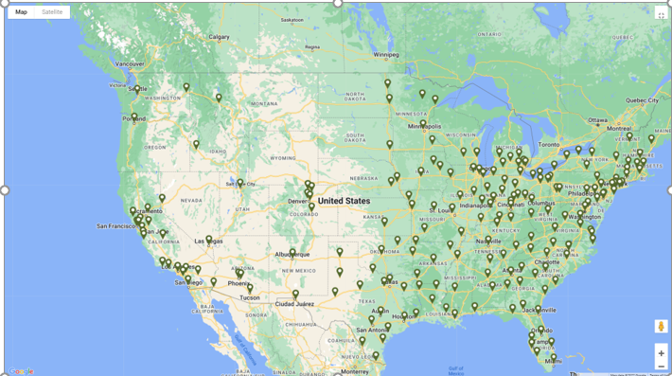
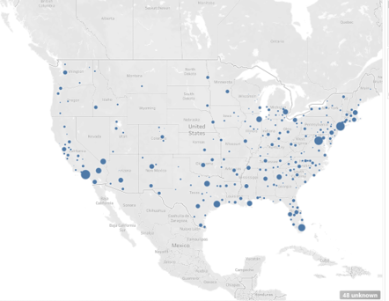
Conclusion COnclusion Figure 8 FIGURE 9 Feeding America Food Bank Map Poverty Map by state and MSA NOTE: Adapted from Find a Food Bank, 2022. NOTE: Poverty map by state and MSA, BY R. Klein, 2022. (https://www.feedingamerica.org/find-your-local-foodbank) In the public domain.
Notes:
While the results of the study was a failure to reject the null hypothesis because of insufficient support for the alternate hypotheses. There was significant progress made in accessing the feasibility of utilizing data analytics and data visualization for current and predictive resource allocation management. With the possible study of monthly CPS data for time series information, and the use of other more powerful tools Feeding America is moving closer to being able to use high quality publicly available data and tools for 100% resource allocation. If you are not convinced see the final two figures on the screen. The first shows a food bank map from the Feeding America website, the second is an analysis of poverty (can be swapped for unemployment, food stamps, and free/reduced lunch) by state and MSA. This data looks very similar. In fact, the poverty map on the right shows possible locations in Montana, Oregon, New Mexico, and s.w. Texas where food banks or pantries may be needed, thus helping Feeding America in its mission to eradicate hunger.

Slide 16
References
Cole, C. (2021). 5 Principles of Data Ethics for Business. Retrieved from https://online.hbs.edu/blog/post/data-ethics.
Davis, K., & Patterson, D. (2012). Ethics of big data: Balancing risk and innovation. Farnham: O'Reilly.
Dukhnytskyi, B. V. (2020). Actual problems in food supplying to the world’s population. Ekonomika APK, 6, 91–97. https://doi.org/10.32317/2221-1055.202006091
El-Wakeel, F. (2021). Ethics and data analysis go hand in hand. Strategic Finance, 103(6), 11-12. Retrieved from https://csuglobal.idm.oclc.org/login?qurl=https%3A%2F%2Fwww.proquest.com%2Fscholarly-journals%2Fethics-data-analytics-go-hand%2Fdocview%2F2614647439%2Fse-2%3Faccountid%3D38569
Erete, S., Ryou, E., Smith, G., Fassett, K., & Duda, S. (2016). Storytelling with Data: Examining the Use of Data by Non-Profit Organizations. CSCW '16: Proceedings of the 19th ACM Conference on Computer-Supported Cooperative Work & Social Computing, 2016, 1273-1283. https://doi.org/10.1145/2818048.2820068
Feeding America. (2022). Hunger in America. Retrieved from https://www.feedingamerica.org/hunger-in-america.

Slide 17
References
Oracle. (2002). Fundamental Data Security Requirements. Retrieved from https://docs.oracle.com/cd/B10501_01/network.920/a96582/overview.htm.
Sarikaya, S., & Buhl, H. U. (2021). The Challenge of Resource Allocation in the Nonprofit Sector: Determining the Right Amount of Fundraising Expenses. Journal of Nonprofit & Public Sector Marketing, 33(1), 1–28. https://doi.org/10.1080/10495142.2019.1708527
Stitch. (2022). What is data transformation: definition, benefits, and uses. Retrieved from https://www.stitchdata.com/resources/data-transformation/.
Talend. (2022). What is Data Integrity and Why is it Important? Retrieved from https://www.talend.com/resources/what-is-data-integrity.
Techopedia. (2016). Availability. Retrieved https://www.techopedia.com/definition/990/availability#:~:text=Techopedia%20Explains%20Availability-,What%20Does%20Availability%20Mean%3F,and%20in%20the%20correct%20format.
U.S. Census Bureau. (2021). Privacy in Census Bureau Statistics[Video]. https://www.census.gov/library/video/2021/protecting-privacy-in-census-bureau-statistics.html.
West, A. (2019). Data-Driven Decision Making for Not-for-Profit Organizations. CPA Journal, 89(4), 10–12.
Wieringa, J., Kannan, P.K., Ma. X., Reutterer, T., Risselada, H., & Skiera, B. (2021). Data analytics in a privacy-concerned world. Journal of Business Research, 122, 915-925. https://doi.org/10.1016/j.jbusres.2019.05.005

